Slide 1

Robotic Exploration for Mapping: Systems and Algorithms
Doctoral Dissertation
PhD Candidate: Hao Men PhD Advisor: Professor Kishore Pochiraju
Committee: Professor David J. Cappelleri
Professor George Kamberov
Professor Souran Manoochehri
Professor Yan Meng
Design and Manufacturing Institute
Department of Mechanical Engineering Stevens Institute of Technology
March 28th, 2012

Slide 2
Overview
Introduction to robotic mapping & exploration
Research objectives
Robotic exploration and mapping process
System: Remotely Operated Autonomous Mapping System
Color point cloud processing and registration
Point cloud analysis
Color point cloud segments coarse registration
Hue Assisted Iterative Closest Point Algorithm for fine registration
Path planning strategy for exploration
Conclusions
Future Works

Slide 3
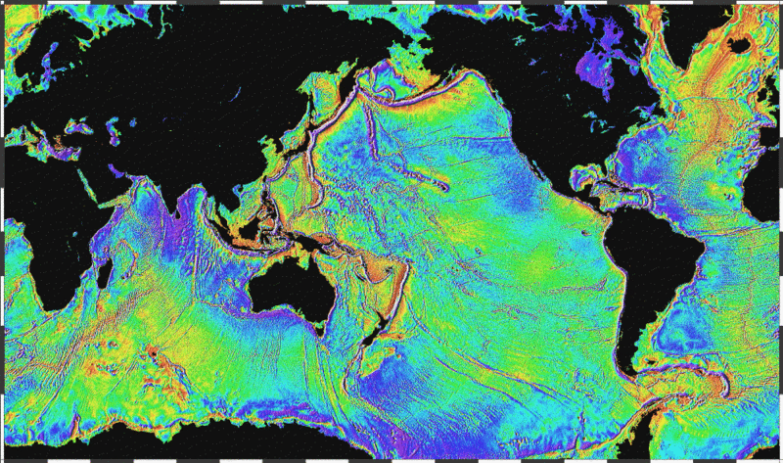
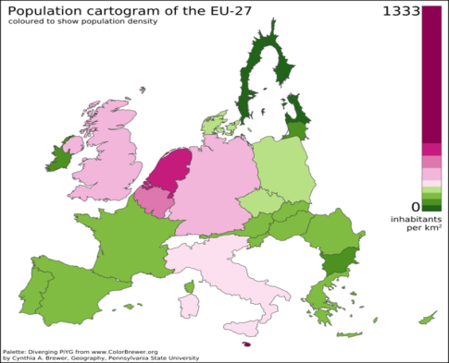
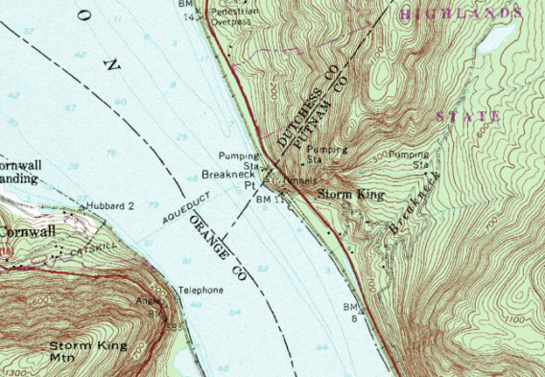
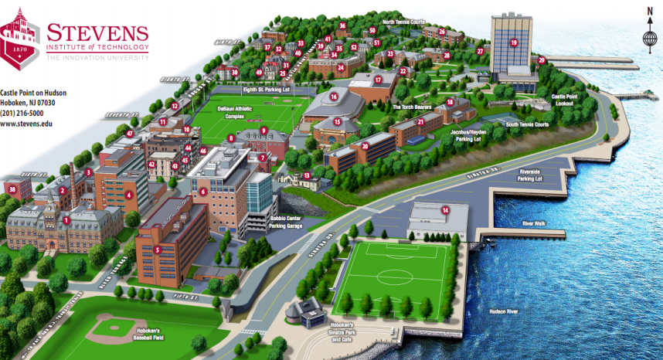
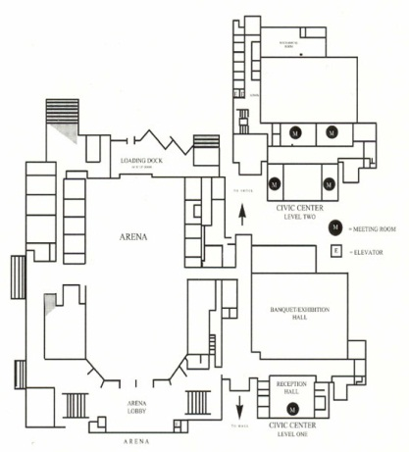
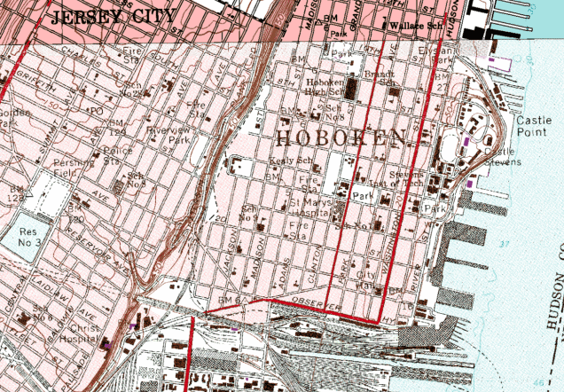
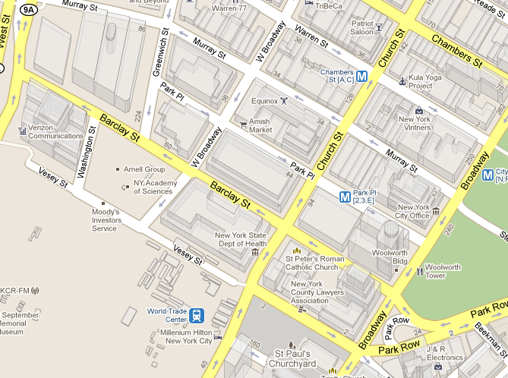
Introduction: Map
Map is a static visual representation of an area to symbolically describe dimensions and relationships between elements of specific space such objects, regions and themes [S. Thrun 2002].
Map of large underwater features, NOAA
Map of EU population distribution
Hudson Highlands State Park Topological Map
Map of Hoboken, USGS
Stevens Campus 3D Map
Building 2D Drawing
Notes:
What is map? Why map is important?
NOAA=National Oceanic and Atmospheric Administration
Dimension accurate
Replace the google map with Stevens Campus 3D Map?

Slide 4
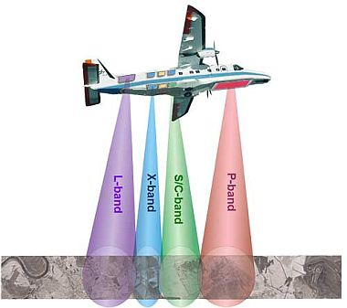
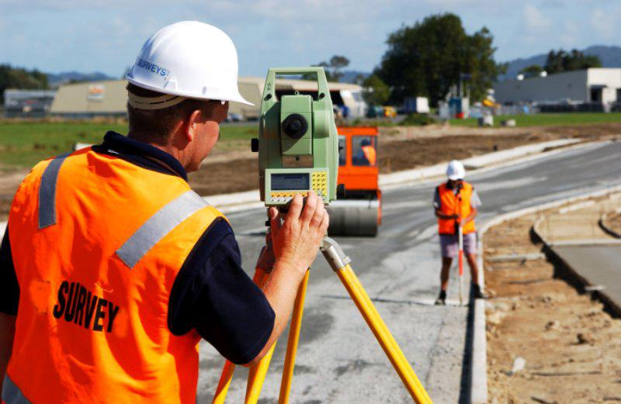
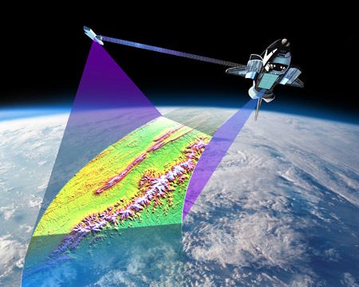
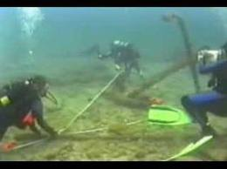
Introduction: Map Construction
Carry ranging devices to measure object surface dimensions.
Urban surveying
German Aerospace Center Airborne Synthetic Aperture Radar(SAR)
NASA Space Shuttle Radar Topography Mission
Underwater Archaeology Mapping
Notes:
theodolite

Slide 5
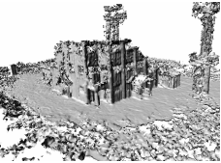
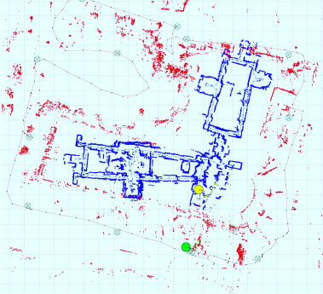
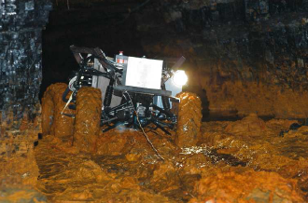
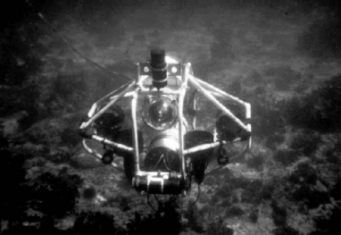
Robotic Mapping
Utilize a robotic platform to carry the mapping device to explore an area and generate the complete map.
Saves mapping costs.
Decreases time consumption.
Work in hazardous environment.
Search & Rescue, M. Montemerlo, 2004
Urban surveying, S. Thrun, 2004
Mine mapping, S. Thrun, 2003
Underwater mapping, S. Williams, 2001
Notes:
Mention Earthquake Tsunami and nuclear radial leakage .
Add carnegie building 2nd floor 40 pos map.
* Why need robotic mapping

Slide 6
Research Objective
Objective Autonomously explore and generate a global 3D color point cloud map about a given area with no pre-known knowledge and positioning sensor.
System
A mobile mapping robot to generate 3D color point cloud maps .
Process
Create a adaptive exploration and mapping process in unknown urban environment.
Algorithms
Point cloud analysis
Occlusion detection, noise filtering, normal extraction, subsampling
Color point cloud map registration
Register maps generated at different positions into global frame.
Exploration strategy
Navigate robot to next best vantage position to compensate occlusions.
Notes:
Objective of robotic mapping

Slide 7
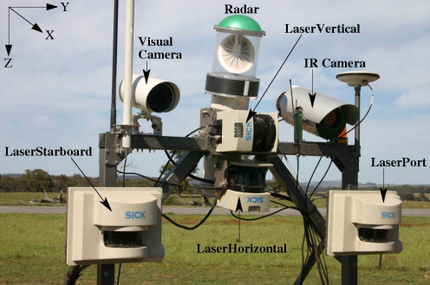
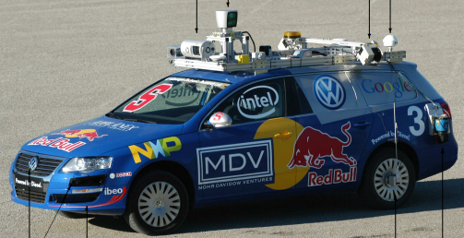
State of the Art
Systems
Different mapping devices have been introduced for accurate map generation and localization.
Sonar (S. Williams, 2001)
Multiple 2D laser ranger(M. Montemerlo, 2004)
Camera (J. Neira, 2008)
T. Peynot, 2004
M. Montemerlo, 2004

Slide 8
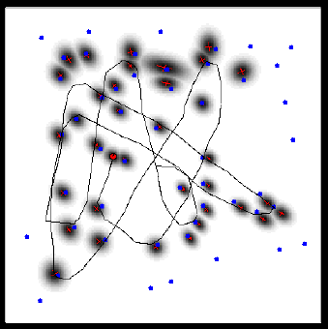
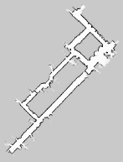
State of the Art
Process
Simultaneous Localization and Mapping (SLAM) methods to complete mapping from different scan segments . (J.A. Castellanos, 1999)
Monte Carlo methods to increase the robustness. (S. Thrun, 2000).
Stop-Scan process for accurate 3D map generation (A. Nüchter, 2007).
Landmarks for error correction
Constructed map

Slide 9
State of the Art
Algorithms
Map registration
Coarse alignment
Extended Gaussian Image (EGI) Algorithm (A. Makadia, 2006).
Signature points from curvature (C. Chua, 1997).
2D Spin image correlation (A. Johnson, 1997).
Principle component analysis (D. Chung 1998, J. Tarel 1998).
Fine registration
Iterative Closest Point (ICP) for fine registration (Bsel, 1992).
Parallel methods for ICP (C. Langis, 2001).
Color is applied as filter in ICP (S. Druon, 2006).
Exploration
Semantic hierarchy of spatial representation (Kuipers, 1991).
Greedy strategy. (S. Thrun, 2002).
Frontier based exploration strategy (B. Yamauchi, 1998).

Slide 10
1. Robotic Mapping Systems
Systems
Analysis
Registration
Exploration
3D color mapping system .
Mobile carrier to navigate through given area.
Exploration and mapping process.

Slide 11
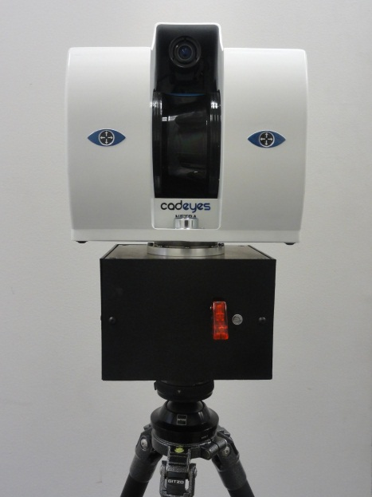
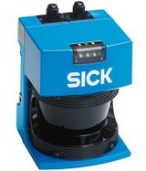
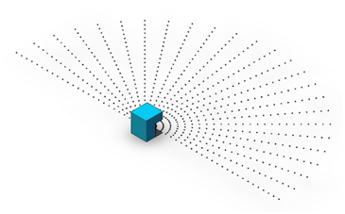
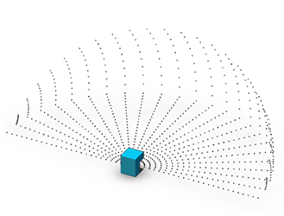
3D Point Cloud Map Generation
Systems
Analysis
Registration
Exploration
2D Light Detection and Ranging-LIDAR: SICK LMS 200.
External rotary actuator used to rotate the LIDAR within a scene.
The position of the rotary actuator is used to create the third dimension.
2D LIDAR Scan
3D LIDAR scan using
external rotary actuator
SICK LMS 200 2D LIDAR

Slide 12
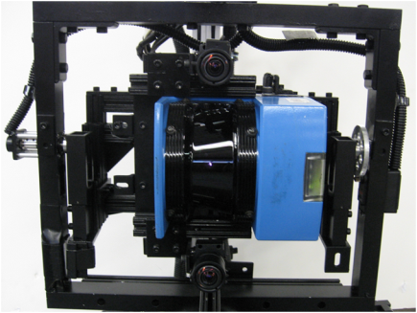
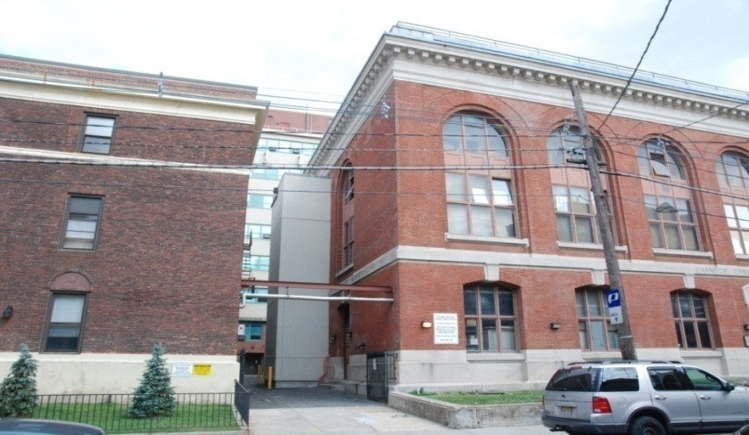
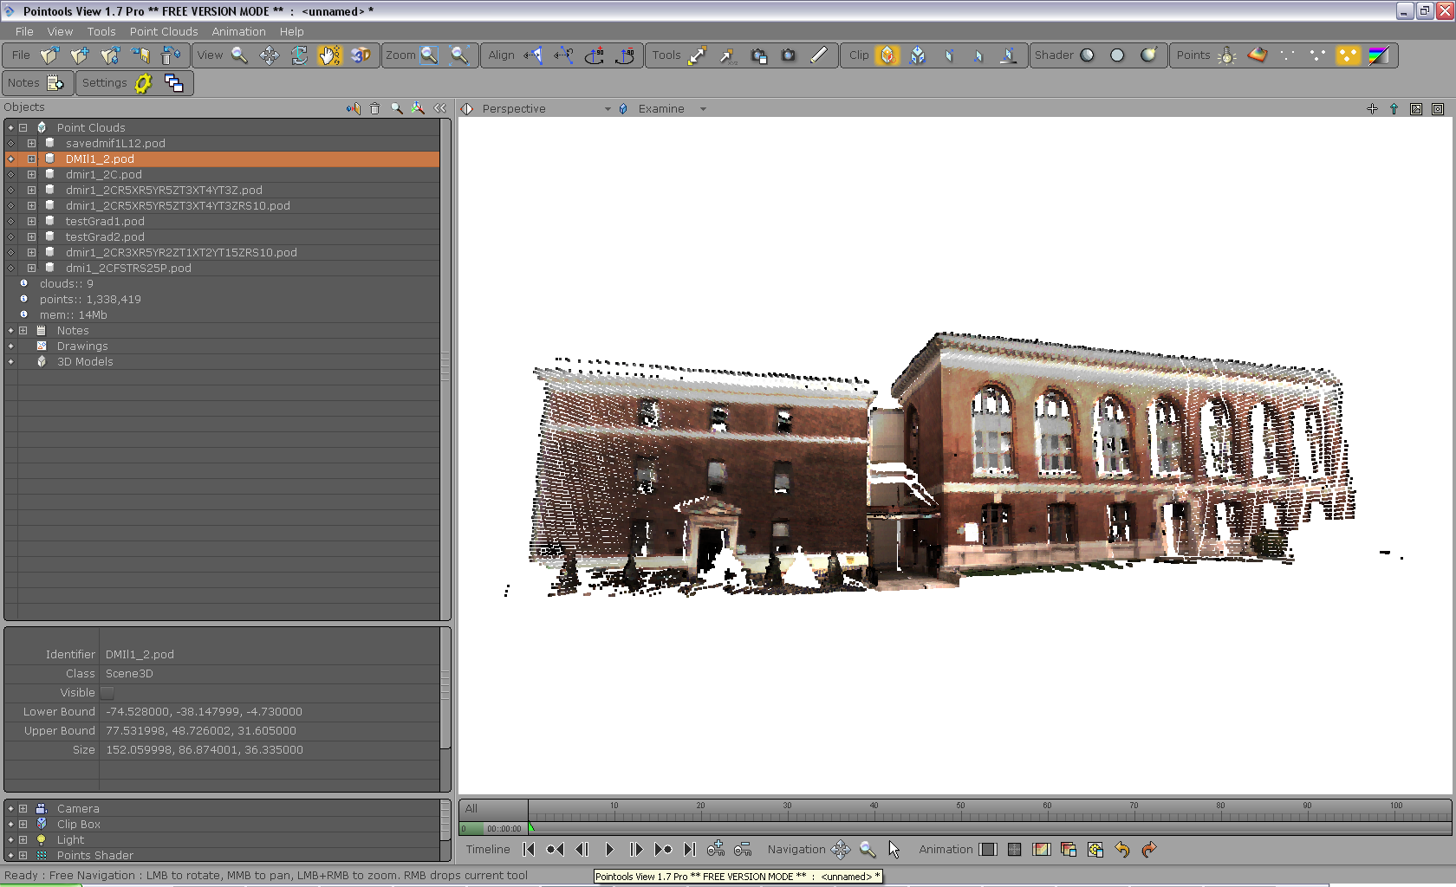
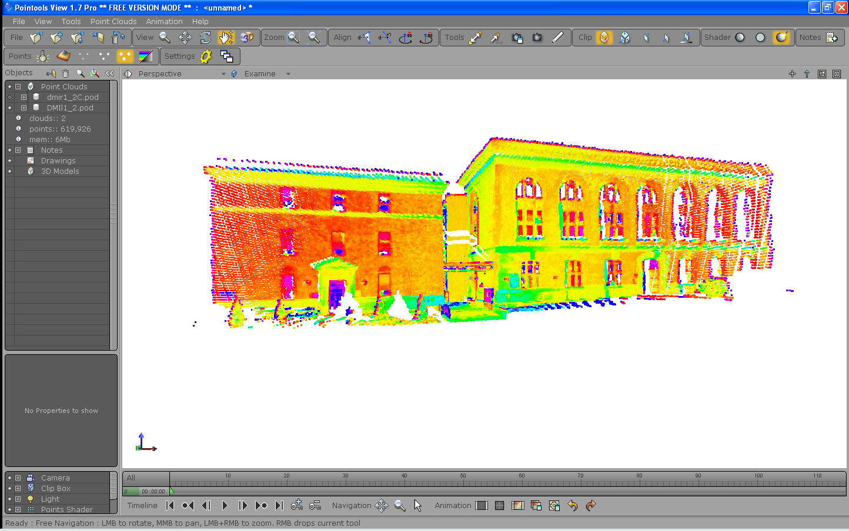
Color Mapping Device & Color Point Clouds
Systems
Analysis
Registration
Exploration
φ
Camera
2D LIDAR
θ
Motors
Mechanism to register camera image to LIDAR range map
Camera image of urban building
Color range map
Laser reflective intensity range map

Slide 13
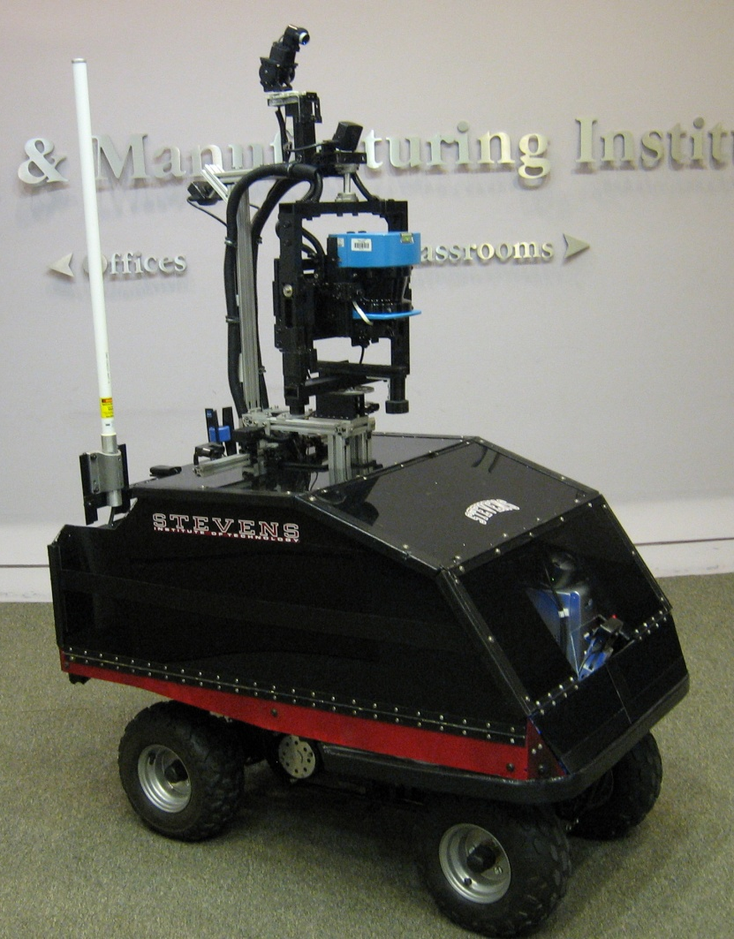
Systems
Analysis
Registration
Exploration
Remotely Operated and Autonomous Mapping System (ROAMS) *
Birds eye view Pan-Tilt HD video camera with acoustic microphone
Forward facing wide angle Camera (main driving camera)
Rear facing wide-angle video cameras
3-DOF video registered LIDAR Scan Systems.
Long range wireless communication system antenna
2 Front facing long range (5.5m) IR proximity sensors.
4 rear facing long range (5.5m) IR proximity sensors. Running across the width of the vehicle.
On board Quad Core computer (Inside)
2 Front facing short range (1.5m) IR proximity sensors
Wide angle front bumper video Camera
* B. Gebre, H. Men, K. Pochiraju, “Remotely Operated and Autonomous Mapping System(ROAMS),” IEEE International Conference on Technologies for Practical Robot Applications (TePRA), pp173-178, 2009

Slide 14
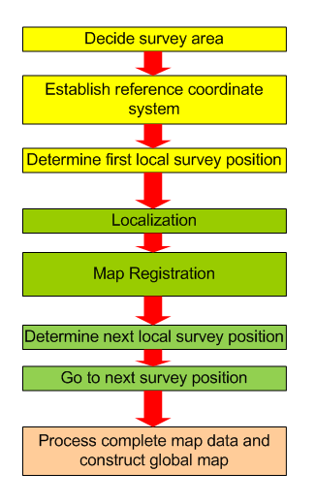
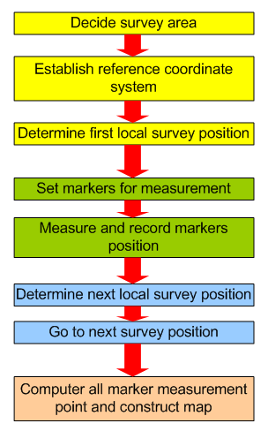
Systems
Analysis
Registration
Exploration
Urban Mapping Process
Survey Initialization
Initialization
Spatial Data Acquisition
Automated Mapping
Complete Surveying
Map integration
Traditional mapping process
Robotic exploration and mapping process

Slide 15
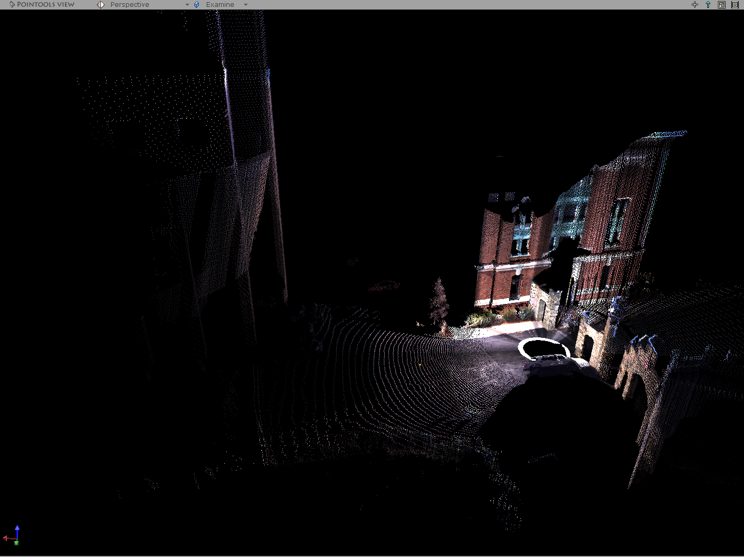
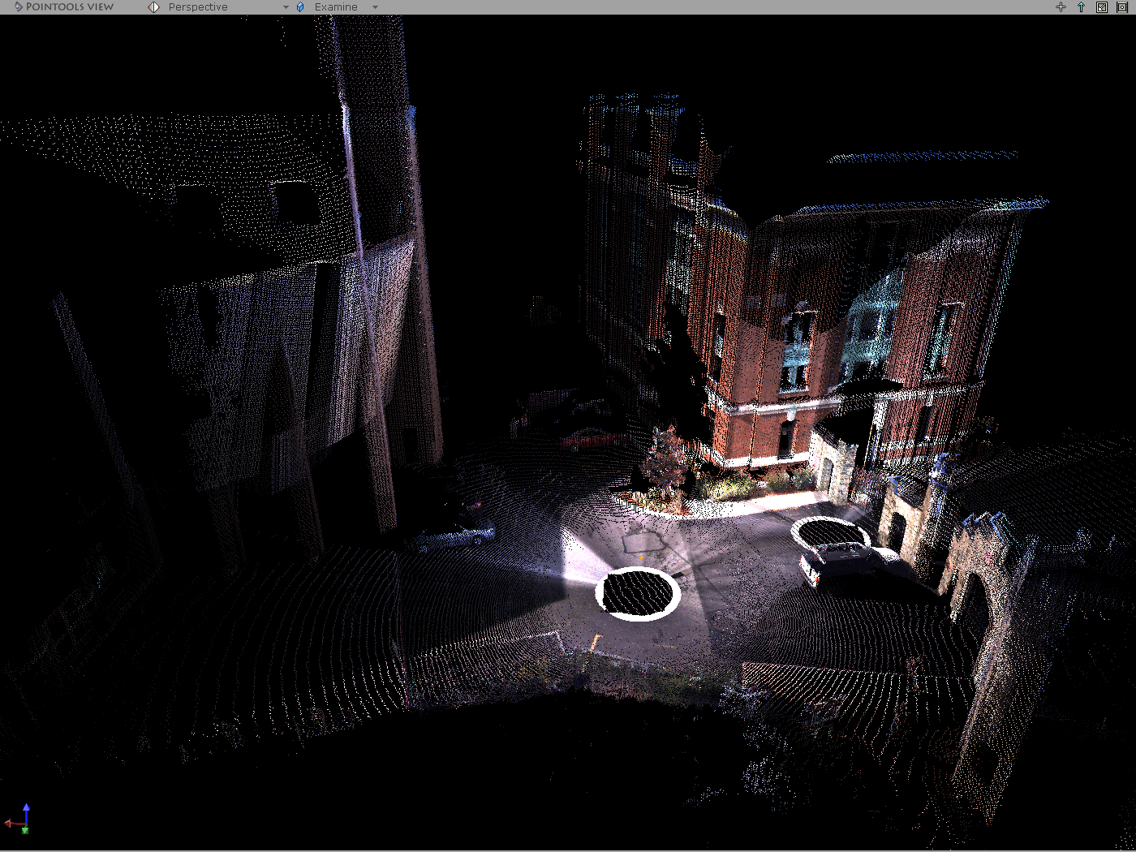
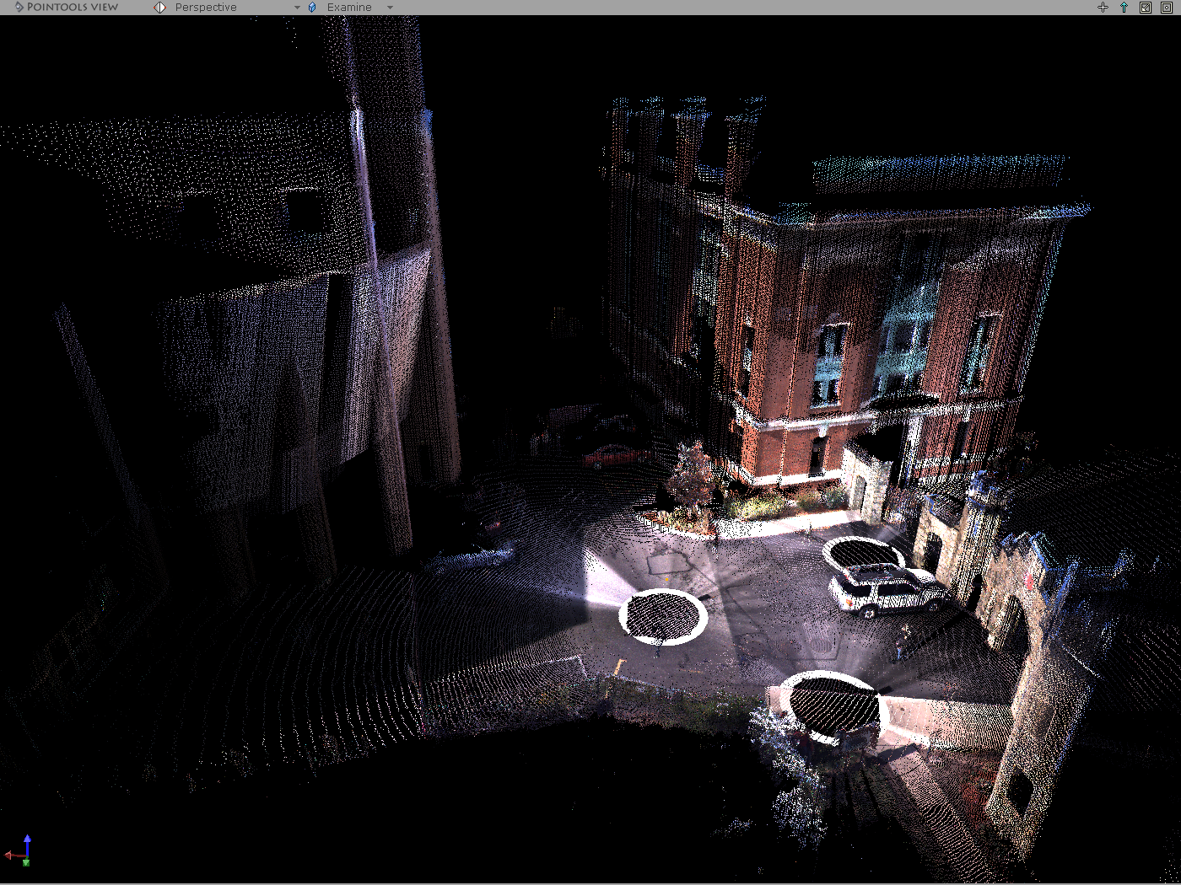
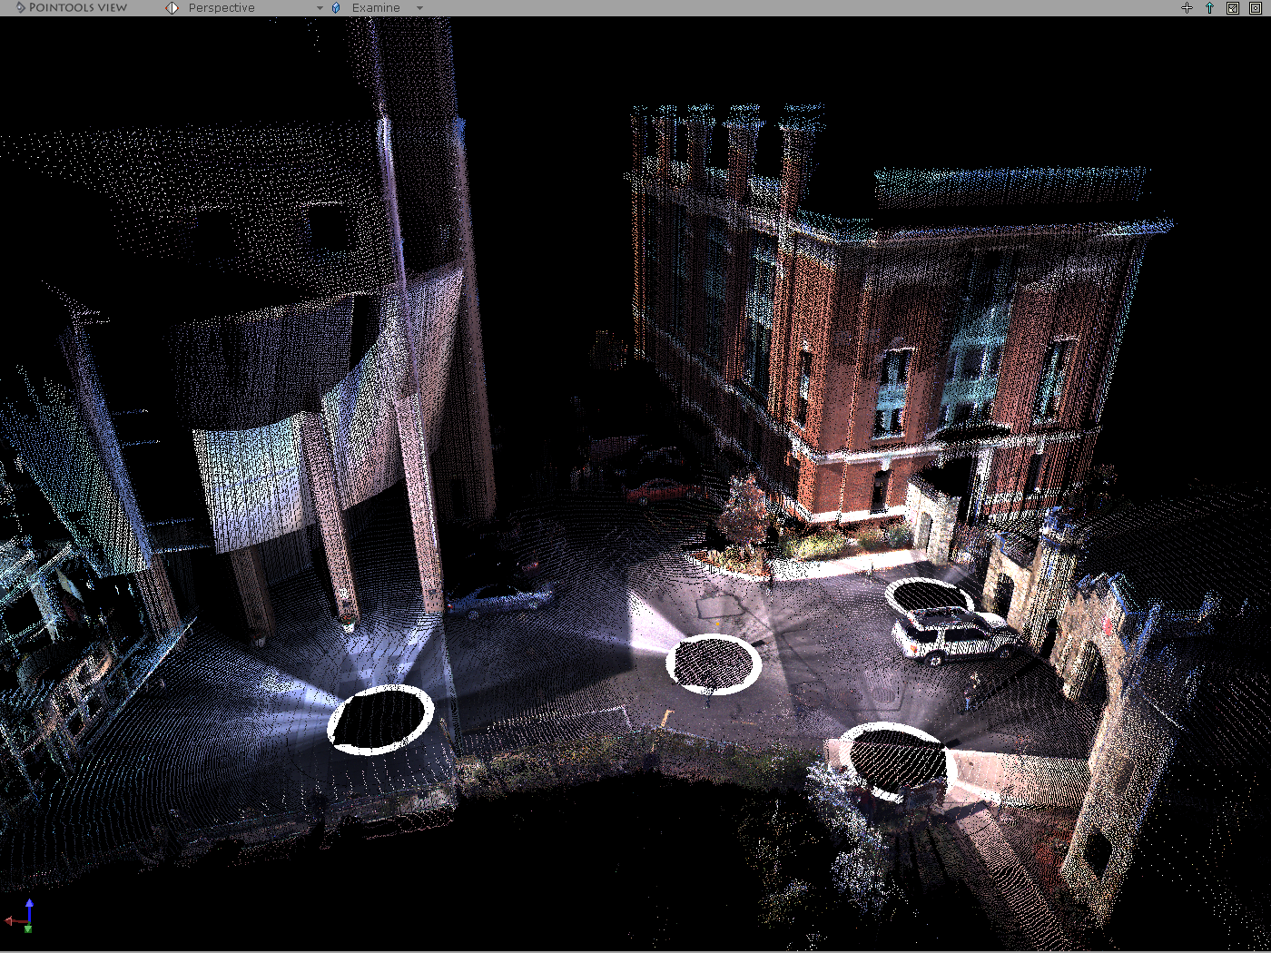
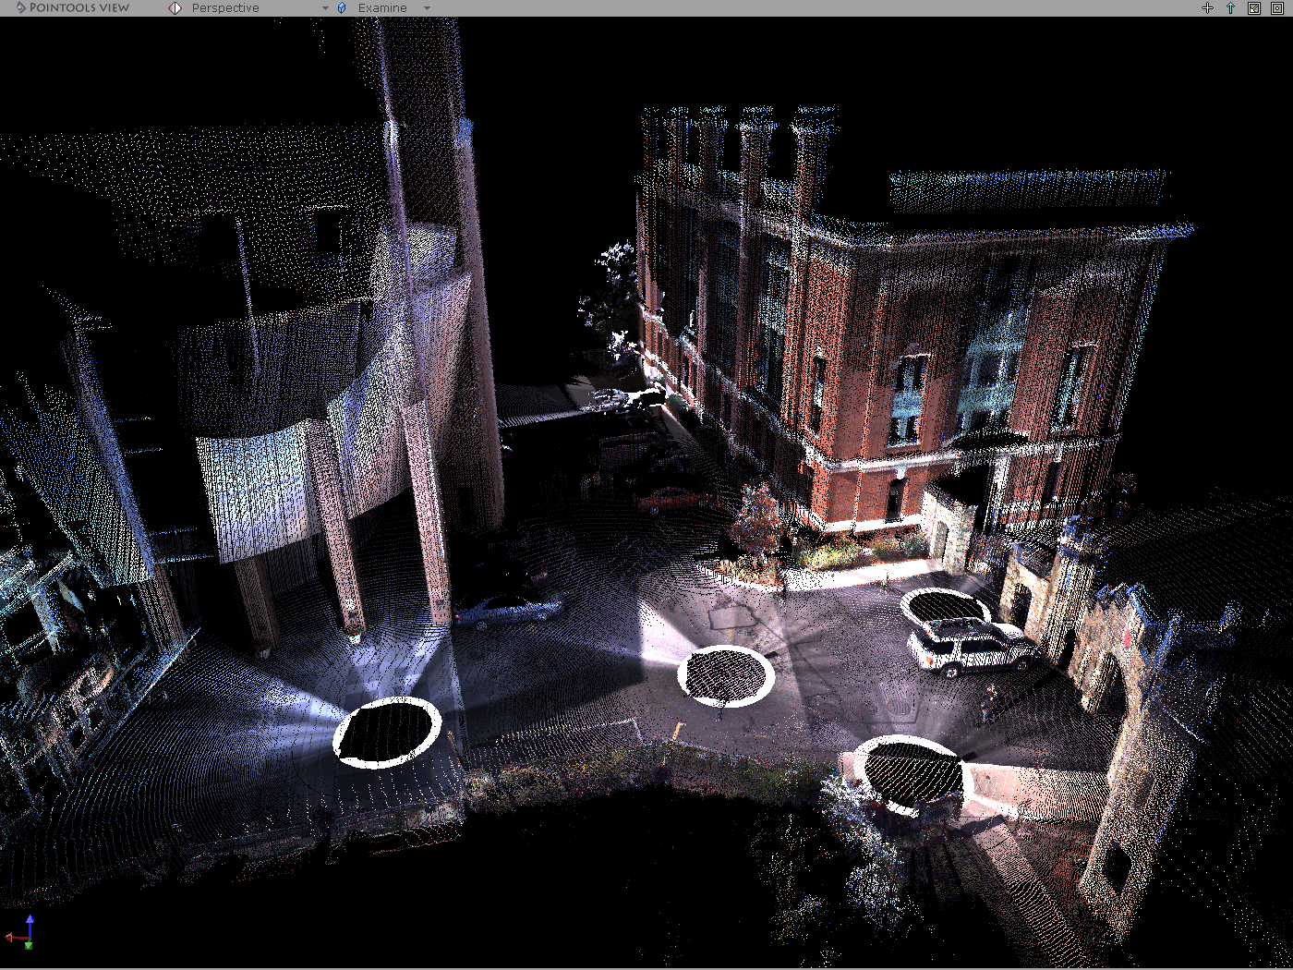
Exploration and Mapping Process
Motivations
1.Initialize global coordinate.
2.Find object in current scene.
3.Determine next observation
position
5
1. Register into global coordinates.
2. Find missed parts in current scene.
3. Determine next observation position.
1
2
4
3

Slide 16
Stop-Scan Mapping Process
Systems
Analysis
Registration
Exploration
Advantages:
Use low precision position information.
Generate accurate global map with low cost.
Large scale high density point cloud generation.
Sense
Generate point cloud map from mapping device.
Analysis
Identify objects and occlusions, noise filtering, de-sampling.
Registration
Register local map into global reference frame.
Plan & Act
Determine next best vantage position to cover unmapped area.
Notes:
Compare different mapping fashions: real-time SLAM mapping (non-accurate landmark mapping)
Stop-scan fashion: non real-time but higher density more accurate map generation.
Mention accurate position sensor is very expensive.

Slide 17
2 Point Cloud Analysis
Systems
Analysis
Registration
Exploration
Noise filtering
Point cloud surface normal extraction
Voxel grid based de-sampling
Occlusion detection in 3D space
Exploration grid construction

Slide 18
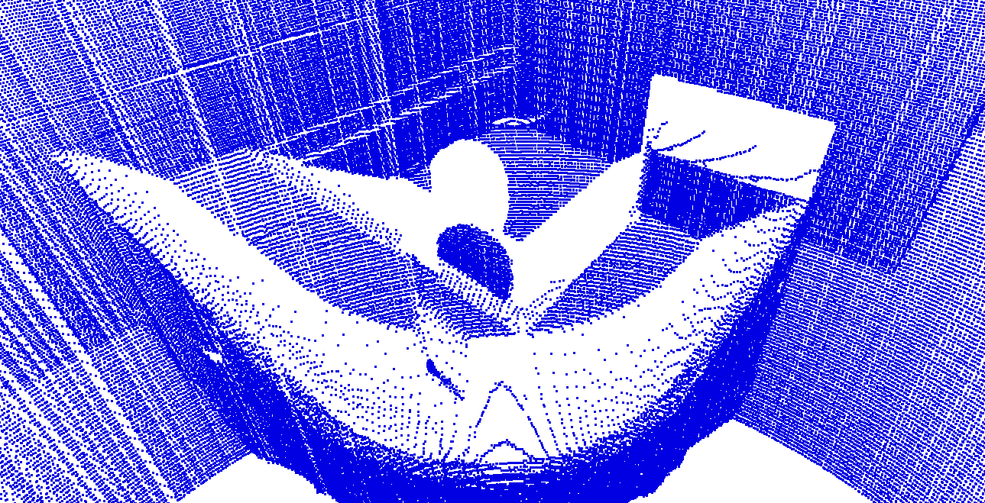
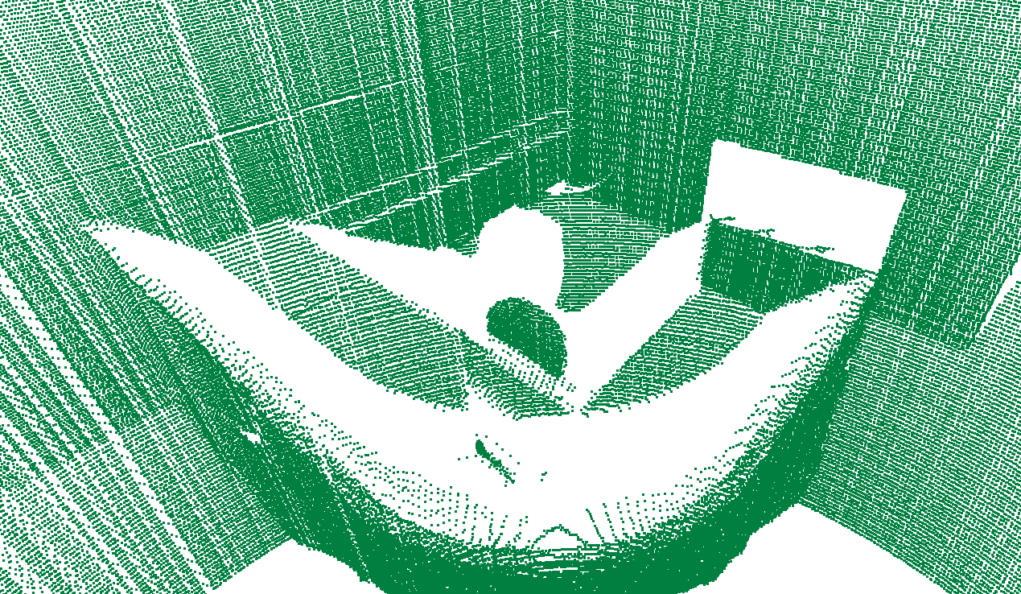
Systems
Analysis
Registration
Exploration
Noise Filtering
Most of the noise points are outlier points.
Rest of the noise comes from the reflection on dark surface.
Filter performs based on computing point space density d=N_{p}/u.
The points search in unit space is completed based on k-d tree search.
Noise Points
3D Point Cloud with noise
After noise filtering

Slide 19
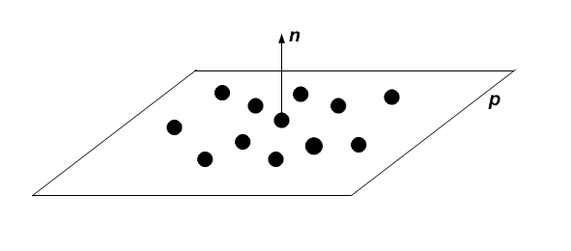
Systems
Analysis
Registration
Exploration
Point Surface Normal Extraction
Search k nearest points P_{nn}{p₁,…p_{k}} for point p_{i.}
Fit nearest points set P_{nn} into a plane P_{l.}
Computing the plane surface normal n_{pl} as surface normal on p_{i.}

Slide 20
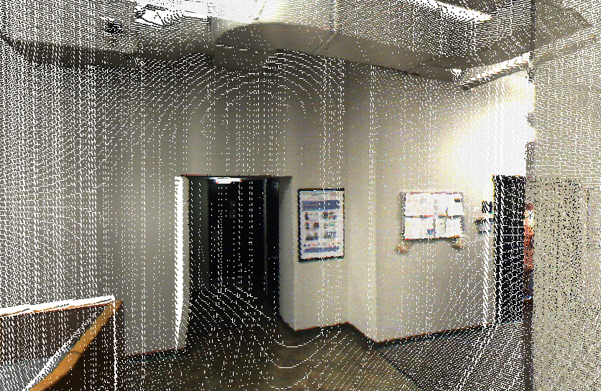
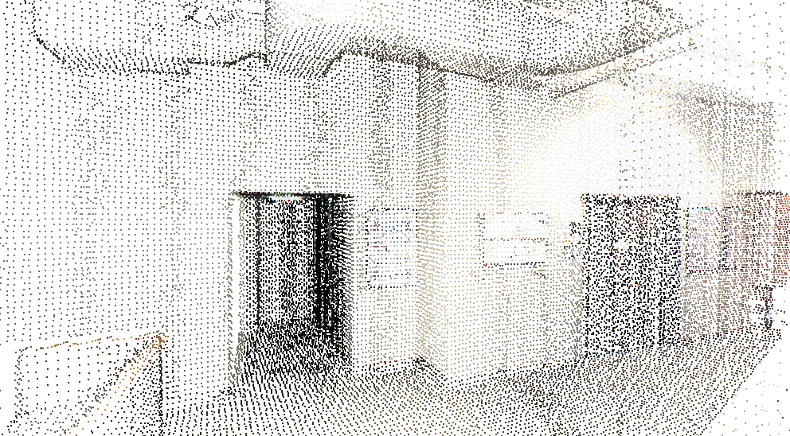
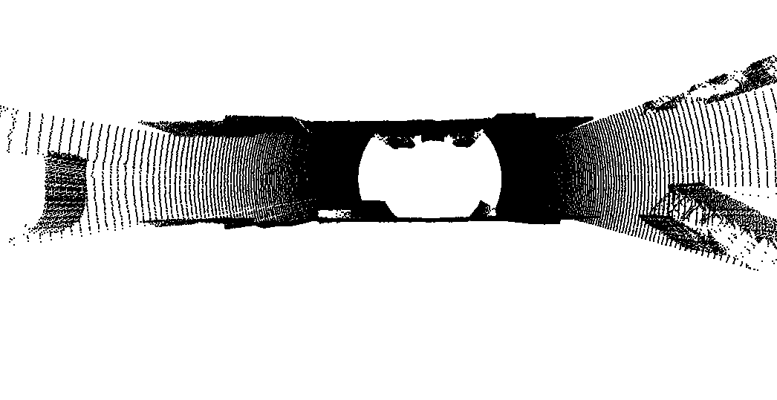
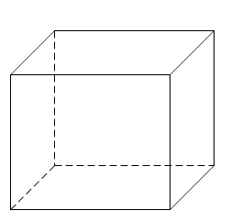
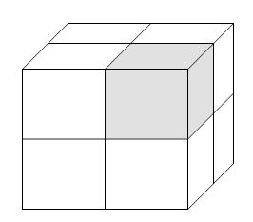
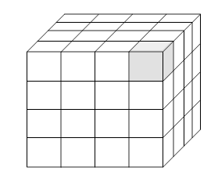
Systems
Analysis
Registration
Exploration
Voxel De-sampling
Construct octree on the bounding box of point cloud.
Increase octree level until reaches desired voxel size.
Keep one point in each voxel to ensure the even space distribution.
Vantage Position
Y
X
Z
Bounding box
1st level octree
2st level octree
Before
After

Slide 21
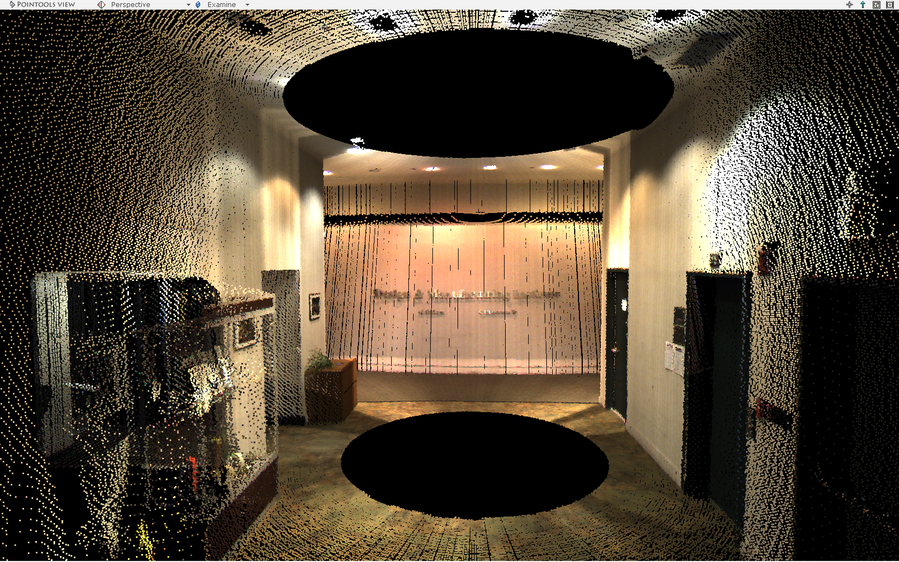
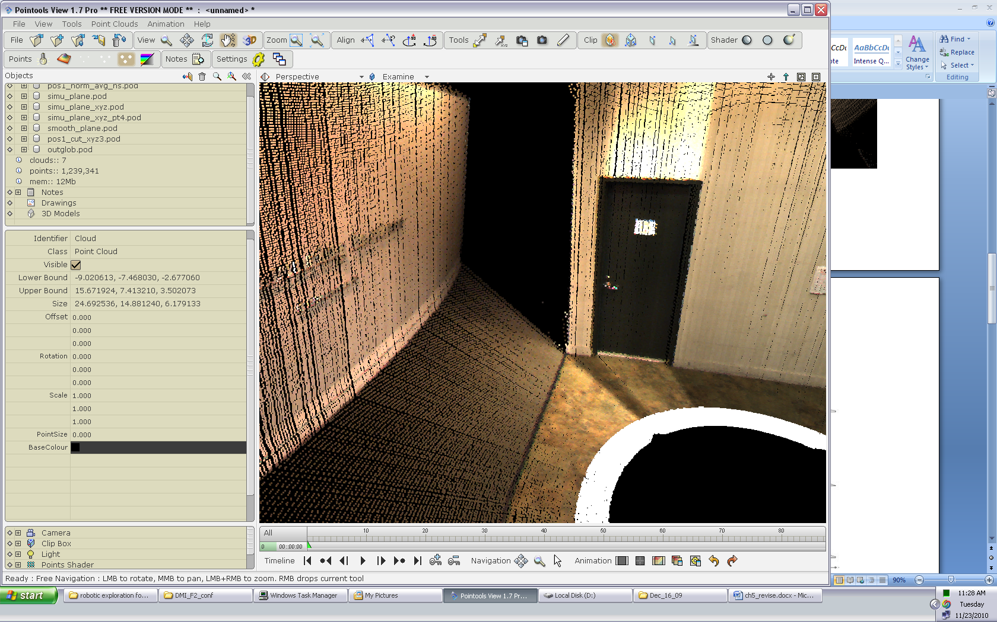
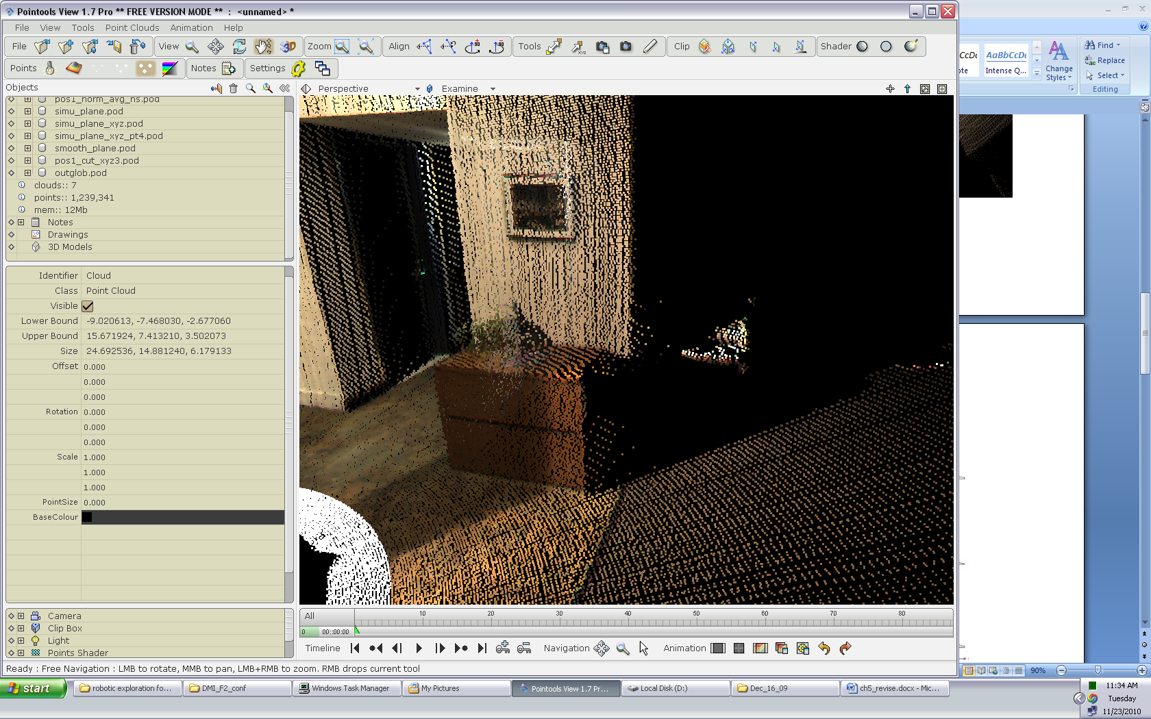
Occlusion in Single Vantage Position Map
Systems
Analysis
Registration
Exploration
Occlusion
Blind Areas
Occlusion
Indoor scanned cloud point cloud map with blind areas and occlusions

Slide 22
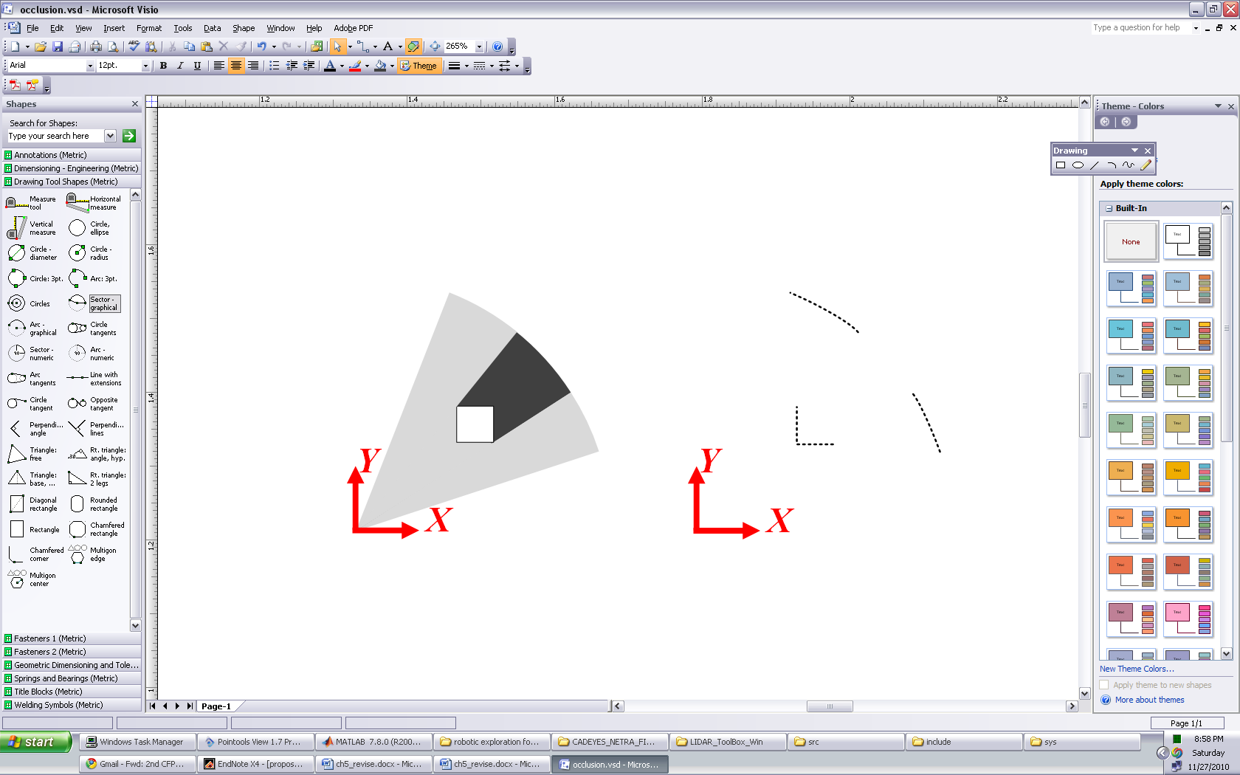
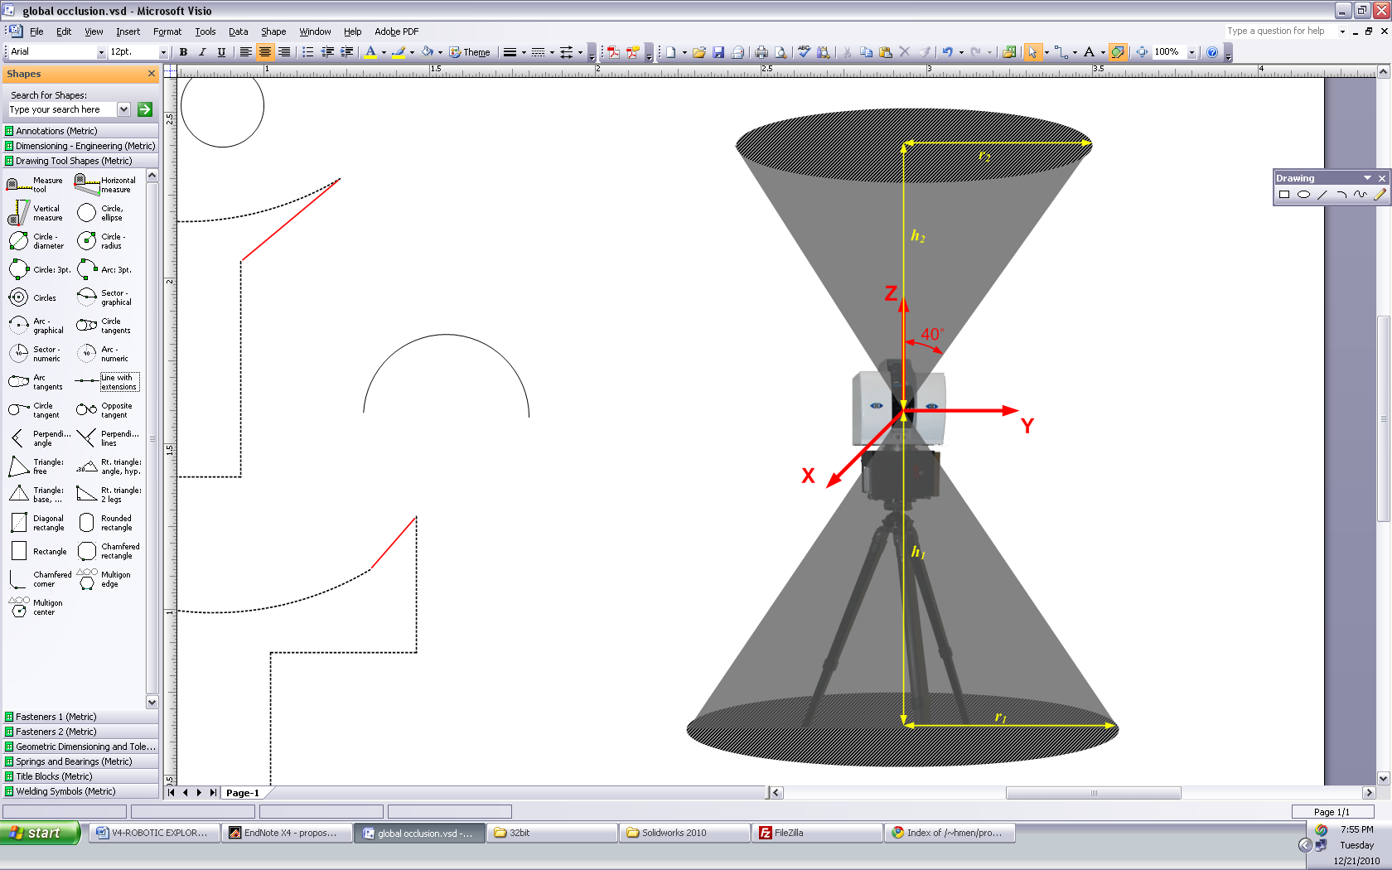
How Occlusion Occurs
Systems
Analysis
Registration
Exploration
Scanner blind area
Occlusions
Occluded space
Discontinued edge
Object
Scanned area
Blind Area
Point cloud data with occlusions

Slide 23
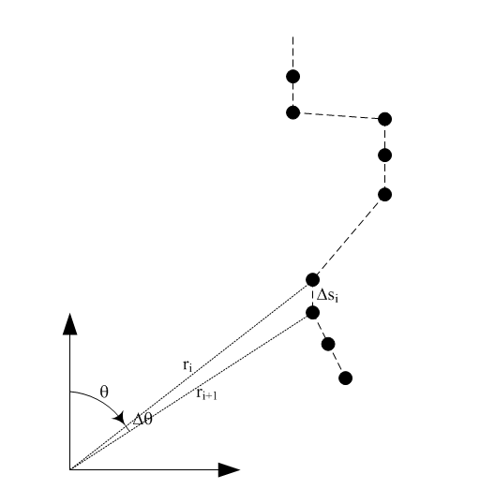


3D Scan Pattern
Systems
Analysis
Registration
Exploration
Scan plane
Object surface
Intersection
3D scanner scan pattern
Laser points
Point measurement on 2D scan plane

Slide 24

Occlusion Determination
Systems
Analysis
Registration
Exploration
Occlusion happens when the distance Δs_{i} between the i^{th} point and i+1th point become discontinuous.
Compute α to determine occlusions Apply α=5º as threshold value for occlusion determination
Notes:
Delta theta is know from the lidar resolution

Slide 25



Occlusion Detection Results
Systems
Analysis
Registration
Exploration

Slide 26

Exploration Grid
Systems
Analysis
Registration
Exploration
Advantages:
Represent occupancy information about mapping progress.
Identify obstacles, mapped and unmapped area for exploration.
Computation cost is reduced from the point cloud processing.
Initialization:
Utilize given bounding for exploration as boundary of exploration grid.
Decide grid size based on the characteristics of mapping platform.
On each grid, determine N elevation levels to describe point distribution.
Update:
For every point in latest generated point cloud, project them on exploration grid.
Analyze z distribution pattern to identify objects.
Color Point Cloud
Exploration Grid

Slide 27



Exploration Grid
Systems
Analysis
Registration
Exploration
Object Identification
Analyze z-direction point distribution on each grid with known patterns.
Identify obstacles, ground surface and unmapped area.
Wall
Ground and roof

Slide 28
3 Color Point Cloud Registration
Systems
Analysis
Registration
Exploration
Hue invariance analysis
Hue assisted color point cloud registration on EGI (coarse registration)
Hue Assistant ICP (HICP) algorithm (fine registration)

Slide 29



Point Cloud Registration
Systems
Analysis
Registration
Exploration
Two point clouds (Data & Model) are registered together into a single frame by rigid translation and rotation.
Approach
Set up model and point cloud with their local reference frames.
Rough alignment based on spherical and translational correlation algorithm.
Fine registration with high precision based on Iterative Closest Point (ICP) algorithm.
Data
Model

Slide 30
Coarse Alignment with
Systems
Analysis
Registration
Exploration
Extended Gaussian Image (EGI) algorithm provides non-iterative solution for point cloud registration.
Point cloud surface normal histogram on Extended Gaussian sphere.
The alignment is determined by maximizing the correlation function between their extended Gaussian Images.
EGI is applied to solve rigid rotation R and translation T.
Rotation alignment is determined before translation alignment.
Stanford bunny point clouds have been applied as benchmark for coarse alignment verification.
EGI of point cloud normal histogram

Slide 31
Coarse Rotation Alignment
Systems
Analysis
Registration
Exploration
.
Rotation alignment is targeting to maximize the correlation function about rotation
H₁(ω) and H₂(ω) are the surface normal histograms on EGI.
ω is the point cloud surface normal vector.
rotation matrix . , SO(3) is a Lie rotation group about origin, R can be described as R=R_{z}(α)R_{y}(β )R_{z.}(γ)
The spherical correlation G(R) is solved in Fourier domain.

Slide 32




Rotation Alignment
Systems
Analysis
Registration
Exploration
Model
Data
Point clouds surface normal are converted into NxN grids EGI.
Rotation alignment is determined by maximizing the correlation function.
EGI of Data
EGI of Model

Slide 33

Coarse Translation Alignment
Systems
Analysis
Registration
Exploration
Translation alignment is determined by maximizing the correlation function.
F(x) is the occupancy function defined as
$τ$ is translation vector.
Both model and data point clouds are covered into NxNxN occupancy grids and the correlation is accomplished by selecting the translation to maximize correlation function G.

Slide 34


Coarse Translation Alignment
Systems
Analysis
Registration
Exploration
Point clouds are converted into NxNxN occupancy grids.
Translation alignment is determined by maximizing the correlation function.
Point clouds before translation
Point clouds after translation
Translation correlation result

Slide 35


Hue Distribution Analysis
Systems
Analysis
Registration
Exploration
Hue distribution between two color point clouds have been analyzed.
Model
Data
Color point clouds before translation
Hue distribution comparison

Slide 36




Hue filtered Color Point Clouds
Systems
Analysis
Registration
Exploration
Hue rendered point clouds before registration.
After low pass hue filter (hue<0.5)
Data point cloud
Model point cloud
Data point cloud
Model point cloud

Slide 37
Hue Constrained Coarse Registration Algorithm
Systems
Analysis
Registration
Exploration
Load data point cloud P_{d} and model point cloud P_{m};
Compute hue on every points in P_{d} and P_{m};
Filter points based on hue distribution;
Filter outlier and voxel de-sampling on both P_{d} and P_{m};
Compute point surface normal n_{d}{1…N_{d}} on data point cloud P_{d} and n_{m}{1…N_{m}} on model point cloud P_{m};
Construct orientation histogram H_{d} and H_{m} based on extracted point normal;
Solve rigid rotation matrix R by solving the correlation between H_{d} and H_{m} with SOFT(3);
Rotate P_{d} with R, get P_{d}’;
Building occupancy grid with common bounding box in P_{d}’ and P_{m};
Solving rigid translation T by solving the convolution of P_{d}’ and P_{m},
Save transformed P_{d}’ for fine registrations.
Error Measurement
In which, point p_{id}{x_{id},y_{id},z_{id}} in point cloud P_{d} looks for its nearest neighbor point p_{im}{x_{im},y_{im},z_{im}} in point cloud P_{m} .

Slide 38



Hue Constrained Registration Result
Systems
Analysis
Registration
Exploration
Build EGI for alignment.
Registration Result.
EGI of Data
EGI of Model
 | 3D Registration | Hue Constrained
Time (second) | 31.572 | 22.599
Error | 0. 001501 | 0. 001482

Slide 39

Eight Color Point Cloud Hue Distributions
Systems
Analysis
Registration
Exploration

Slide 40

Hue Constrained Coarse Registration Performance
Systems
Analysis
Registration
Exploration
Eight Cloud Point Cloud Registered into Global Frame.
Performance is compared with 3D Registration

Slide 41
Iterative Closest Point Algorithm
Systems
Analysis
Registration
Exploration
Initialize point clouds start position
Two 3D color maps are iteratively registered together
Point association happens at every iteration.
Iteration stops after convergence criteria are met.
Pair-wised registration rigidly transforms data 3D map into model 3D map’s coordinates.
Hue assisted algorithm accelerates speed and increases robustness for map registration.
point association
Rigid transformation computation
Transform data point cloud
Mean square error evaluation
N
Meets
Stop Criteria?
Y
Registered point cloud data

Slide 42
ICP Algorithm for Fine Registration
Systems
Analysis
Registration
Exploration
Data is registered into model point cloud frame with ICP algorithm.
ICP algorithm is an iterative process that calculates the rigid transformation based on associating two point clouds.
A transformation error function, E(R,T) is defined as the mean distance between associated points.
R and T are the relative 3D rotation and translation.
The point association of correspondence between the data and model point clouds is based on a nearest neighbor search.
The transformation matrix R and T are then updated by minimizing E.

Slide 43


Points Association Using k-d Tree
Systems
Analysis
Registration
Exploration
K-d tree based closest points association
K-d tree construction
Points are inserted into the tree by selecting the median of the subtree.
The median has been decided sequencing between different dimensions.
K-d tree closest point range search
Search algorithm moves down recursively from root node.
Once search reaches leaf node, leaf node will be considered as candidate.
K-d tree construction
K-d tree closest point search

Slide 44


Introducing Color into ICP
Systems
Analysis
Registration
Exploration
Color point cloud
Acquired by Vision-Laser Range Finder.
Provide more detail color information about scanning object.
Extend point cloud application areas to: object recognition, semantic map building, road detection, etc.
Increase robustness in point cloud registration.
Comparison between range point cloud and color point cloud
3D Range Point Cloud Scan
3D Color Range Point Cloud Scan

Slide 45
Selection of the 4th Dimension from Color Data
Systems
Analysis
Registration
Exploration
Red-Green-Blue (RGB) model is easily affected by lighting conditions and view positions.
Camera image at pos #1
Background filtered
Camera image at pos #2
Background filtered
Different colors RGB distributions at 2 positions

Slide 46
Hue Component Remains Invariant with View Point
Systems
Analysis
Registration
Exploration
Converting RGB into Hue-Saturation-Lightness (HSL) space, hue remains invariant at different view positions.
Different colors hue distributions at pos #1
Different colors hue distributions at pos #2

Slide 47
Hue Assisted Iterative Closest Point (HICP) Algorithm
Systems
Analysis
Registration
Exploration
Hue assisted ICP algorithm
Weighed hue value computed as 4th dimension.
Construct 4D k-d tree.
4D search in 4D k-d tree produces more accurate pairing.
Rigid transformation matrix computation
Singular value decomposition
Error evaluation
Average mean square distance on 3D coordinates
Convergence criteria
Error value converges;
Associated points number converges;
The number of points which changed their paired points compare to previous association goes to 0.

Slide 48
Systems
Analysis
Registration
Exploration
HICP Methodology
Weighted hue in registration process
The point association determination on 4D space is based on:
Both range {x,y,z} and hue h have been normalize to 0~1 range.
Hue weight is selected between 10% and 35% for accurate association.
Different distributions of hue from the scene affect the registration results.
Registration accuracy can also be measured by normal error.
(e) Position #3potential coverage and travel cost (f) Position #4potential coverage and travel cost

Slide 49

Benchmark: 6DOF Registration
Systems
Analysis
Registration
Exploration
Urban building color point clouds registration
Data and model point clouds generation
Same color point cloud from different vantage point view angle.
6DOF transformation is known for comparison.
(T_{x}= 2.46, T_{y}=2.612, T_{z}=0.347, θ_{x}=0º θ_{y}=10º, θ_{z}=10º)
Point clouds are registered together using HICP
HICP results have been compared with 3D ICP.

Slide 50
Benchmark: 6DOF Registration
Systems
Analysis
Registration
Exploration

Slide 51
Performance with Different Hue Weight and 3D ICP
Systems
Analysis
Registration
Exploration
Weight has bee adjusted from 0.05 to 100.00.
Performance area compared in computation time and error.
Methods | Time (seconds) | Iterations
3-DICP | 166.89 | 51
HICP weight=0.05 | 98.05 | 33
HICP weight =0.10 | 93.07 | 30
HICP weight=0.20 | 87.76 | 28
HICP weight=0.40 | 73.11 | 25
HICP weight=1.00 | 56.06 | 21
HICP weight=2.00 | 52.42 | 19
HICP weight=5.00 | 42.25 | 16
HICP weight=10.00 | 36.21 | 14
HICP weight=100.00 | 28.08 | 12

Slide 52




Two Different Color Point Cloud Registration with H-ICP
Systems
Analysis
Registration
Exploration
Two color point clouds about indoor scene
Hue rendered point clouds

Slide 53


Two Different Color Point Cloud Registration with H-ICP
Systems
Analysis
Registration
Exploration
Two color point clouds before and after registration
Before registration
After registration

Slide 54
Performance Comparison
Systems
Analysis
Registration
Exploration
Methods | Time (seconds) | Iterations | Error | Normal Error
3-DICP | 678.02 | 108 | 0.066 | 0.9957
HICP weight=0.01 | 437.02 | 93 | 0.041 | 0.9968
HICP weight=0.02 | 432.58 | 94 | 0.041 | 0.9969
HICP weight=0.05 | 332.69 | 74 | 0.040 | 0.9969
HICP weight=0.10 | 366.60 | 81 | 0.042 | 0.9969
HICP weight=0.20 | 306.15 | 70 | 0.043 | 0.9971
HICP weight=0.30 | 277.61 | 74 | 0.045 | 0.9971

Slide 55

Sequential Registration about Unknown Area
Systems
Analysis
Registration
Exploration
Six color point clouds area generated at six vantage positions.
They area pair wisely registered together to evaluation performance.
3
1
2
6
4
5

Slide 56


Sequential Registration about Unknown Area
Systems
Analysis
Registration
Exploration
Position | 3-D ICP Iteration # | 3-DICP Time(seconds) | HICP Iteration # | HICP Time(seconds) | 3-D ICP Error | HICP Error
2 | 81 | 360.24 | 74 | 263.36 | 0.379 | 0.370
3 | 83 | 203.14 | 37 | 63.43 | 0.303 | 0.301
4 | 84 | 386.54 | 67 | 199.88 | 0.472 | 0.461
5 | 133 | 393.46 | 68 | 329.76 | 0.568 | 0.549
6 | 120 | 465.85 | 71 | 156.69 | 0.947 | 0.849
3D point clouds after registration (pos 2 & pos 3)
Color point clouds after registration (pos 2 & pos 3)

Slide 57


Case I: 1D Distributed Hue
Systems
Analysis
Registration
Exploration
1 dimensional assigned hue point clouds registration
Data and model point clouds generation
Render bunny point clouds with 7 hue value vary from 0 to 1.
Hue rendering is based on z value
Color | R | G | B | Hue
Gray | 128 | 128 | 128 | 0
Yellow | 255 | 255 | 0 | 0.167
Green | 0 | 255 | 0 | 0.333
Cyan | 0 | 255 | 255 | 0.5
Blue | 0 | 0 | 255 | 0.667
Magenta | 255 | 0 | 255 | 0.833
Red | 255 | 0 | 0 | 1
Point Clouds before Registration
Point Clouds after Registration

Slide 58
Case I: 1D Distributed Hue
Systems
Analysis
Registration
Exploration
1D distributed hue point cloud registration
Results have been compared between 3D range data and color rendered 3D range data with range ICP and hue assisted ICP.
Hue attribute helps to increase ICP speed.

Slide 59



Case II: Continuous Hue Distribution
Systems
Analysis
Registration
Exploration
Continuous distributed hue point cloud registration
Data and model point clouds generation
Render range point clouds with continuous hue distribution.
Hue value is ranging from 0 ~ 1.
Hue value is decided based on z direction coordinate.
Model point cloud
Data point cloud
Registered point cloud

Slide 60
Case II: Continuous Hue Distribution
Systems
Analysis
Registration
Exploration
Continuous distributed hue point cloud registration
Result is compared with 7 segments hue point cloud.
Continuous hue point clouds have a better registration performance.
Hue continuity can effect registration process.

Slide 61



Case III: Hue Is Noisy
Systems
Analysis
Registration
Exploration
Noise affect on hue assisted ICP
Data and model point clouds generation
Render range point clouds with 1D 7 layer hue distribution.
Random noise on hue has been added with deviation of 50%.
Noisy point clouds are registered together using hue assisted ICP
Model point cloud
Data point cloud
Registered point cloud

Slide 62
Case III: Hue Is Noisy
Systems
Analysis
Registration
Exploration
Noise affect on hue assisted ICP
Noise effect increases registration error.
Hue attribute increases convergence speed.

Slide 63
Color Point Cloud Map Example (Indoor / Outdoor) (250+ Million Points, 150 Scans)
Systems
Analysis
Registration
Exploration

Slide 64
4. Path Planning for Exploration
Systems
Analysis
Registration
Exploration
Exploration grid construction and update.
Heading direction determination.
Frontier vantage position candidate generation.
Best view vantage position determination.

Slide 65



Exploration Grid Update
Exploration grid is generated from the point cloud based on z-directional point distribution.
Exploration grid describe objects as unmapped area (U), ground surface (G) and obstacles/walls (O).
The exploration grid can be updated by:

Slide 66
Heading Direction Computation
Exploration grids are utilized to computed heading direction for next step movement.
Heading direction H is defined by a force field that attracted by unmapped area and repulsed by the obstacles surface.
The attraction scale factor K_{kI} increases with the distance between unmapped grids and current location. The repulsive scale factor K_{lI} is high for walls that are close by current location.

Slide 67


Vantage Position Generation
Systems
Analysis
Registration
Exploration
Heading direction is utilized to determine the field of frontier detection.
The frontier positions is detected based on accessibility by A* algorithm.
Frontier positions are generated for next vantage position determination.
H=[-0.9963 -0.0856]
Heading direction provide frontier search field
Generated frontier candidate positions

Slide 68


Next vantage position Determination
Systems
Analysis
Registration
Exploration
Computing coverage area based on the LIDAR range.
Determine potential coverage area by considering current known obstacles.
Determine the next vantage position from candidate positions P_{ci} who has largest potential coverage area.
Frontier position coverage area
Frontier position coverage area considering obstacles

Slide 69
Path Planning for Exploration and Mapping
Methodology:
Heading direction calculation based on obstacles and unmapped space.
Frontier exploration strategy to generate candidate vantage positions.
Traversable determination based on A* path planning algorithm.
Next vantage determination from the candidate positions who has largest coverage of unmapped area.
Evaluation:
Occupancy grids of mapping area for map completeness evaluation.
Exploration grid ensures all point density on object surface meet requirement of CAD model extraction.

Slide 70




Exploration and Mapping Result

Slide 71
Concluding Remarks
Design and prototyping the hardware
A mobile robotic platform was designed and built with four-wheel driven all-terrain vehicle.
Stationary 3D scanner was developed for color 3D mapping purpose.
Scan-Stop-Scan methodology for autonomous exploration mapping
No precise location sensor is used and the scan registration depends upon the scene continuity.
The number of stops required by the vehicle depends upon the scanner range
Point Cloud Analysis
Occlusion detection in 3D space based on depth discontinuity.
Point cloud processing with noise filter, voxel de-sampling, normal extraction.
Construction and update of exploration grid from point clouds.
Identify obstacle and ground surface on exploration grid.
Notes:
Highlight contributions after proposal

Slide 72
Concluding Remarks
Color point cloud map registration algorithm
Coarse registration algorithm has been developed to roughly align point clouds together. Hue is utilized as a filter to assist registration process and increase the performance.
Fine registration algorithms have been developed to register observed point cloud map together.
Color property has been introduced into the registration process for accelerating the speed and increasing the robustness.
Path planning strategy for exploration and mapping
Heading direction computation based on force field.
Frontier extraction on exploration grid.
Potential coverage estimation on exploration grid.
Next vantage position determination based on coverage of unmapped area.
Notes:
Highlight contributions after proposal

Slide 73
Future work
Integrating hue into EGI construction process
Weighted hue value can also be combined together with normal histograms to increase the coarse registration process.
Object Surface and Contour Identification.
Surface reconstruction can be completed based on the point cloud analysis result.
Optimization of exploration strategy and map evaluation.
The exploration strategy can be evaluated to optimize trajectory of the exploration process.

